Slide 1

European Food Forum:
The role of climate-neutral products in sustainability for food systems
Bioeconomy and the European agri-food system
Sophia Hub
Senior Policy Analyst
hub@europejacquesdelors.eu
14 November 2023

Slide 2
Bioeconomy as alternative to a fossil-based economy
Decarbonisation of the agri-food sector is closely linked to other economic sectors.
Decarbonisation → defossilisation:
Shift from a fossil-based feedstock to bio-based.
Implications for the EU agri-food sector: use of biomass

Slide 3
Demand for biomass
BIOMASS
Energy
Textiles
Materials/
Fibres, e.g.:
Food
Feed
Chemicals
Packaging
Building/
Construction
Biodiversity restoration and protection/
ecosystems conservation

Slide 4
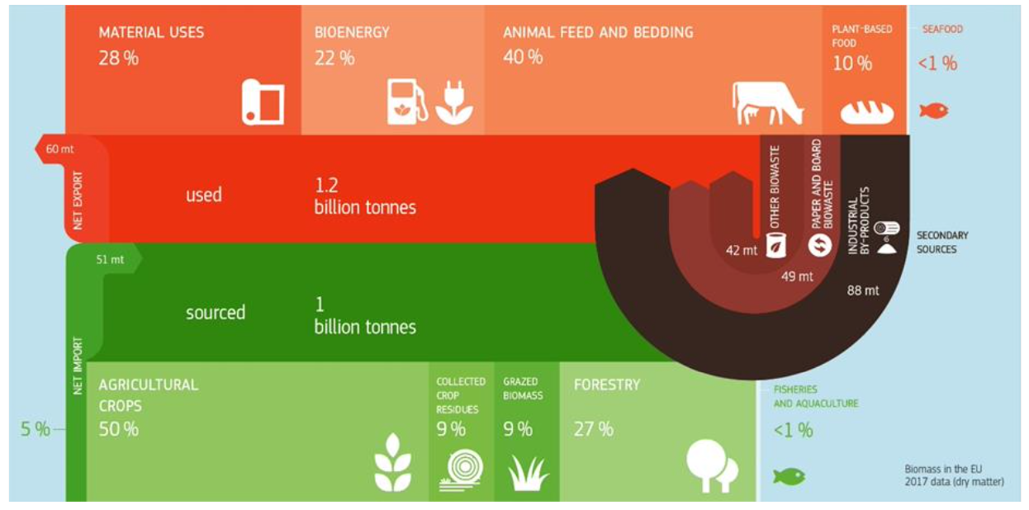
Supply of biomass
Source: Avitabile, V. et al. (2023) Biomass production, supply, uses and flows in the European Union. Integrated assesment, Publications Office of the European Union, JRC132358, doi:10.2760/811744, p. 7

Slide 5
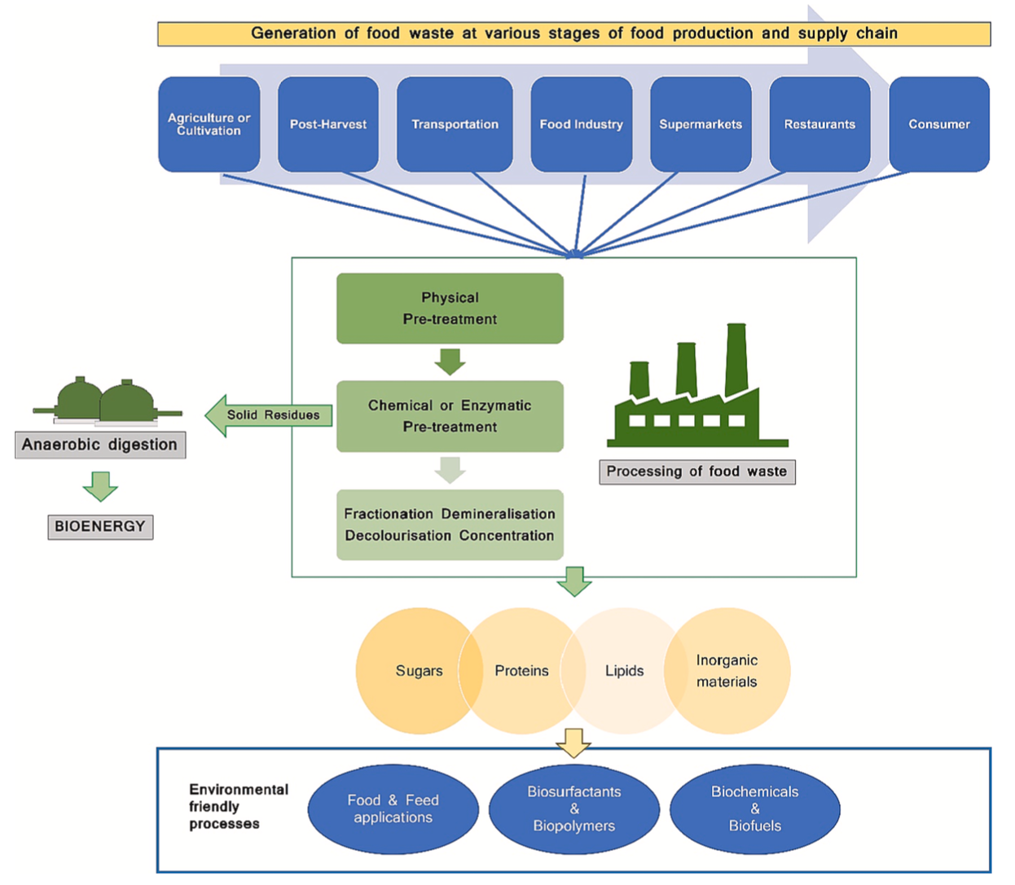
The role of the agri-food sector: supplying biomass
- example: food waste
Circular bioeconomy:
Integration of food, energy and material sectors
Local bioeconomies
(see: EU Biodiversity Strategy)
Source: Narisetty, V. et al. (2022) Integrated biorefineries for repurposing of food wastes into value-added products, Bioresource Technology Vol. 363, https://doi.org/10.1016/j.biortech.2022.127856, p. 2

Slide 6
Policy considerations
Sustainable and resilient agricultural production is the basis.
Need for biomass management/governance:
  Cascading use of biomass
  Prioritising food production?
    Consider: food security, role of market/prices, diversification of farmers’ income
  Reconsider the role of livestock in the future EU agri-food system

