Slide 1
European Food Forum
R&I, solutions in the food supply chain and consumers needs
Caroline Ploux – EU Public Affairs Senior Manager
November 2023

Slide 2
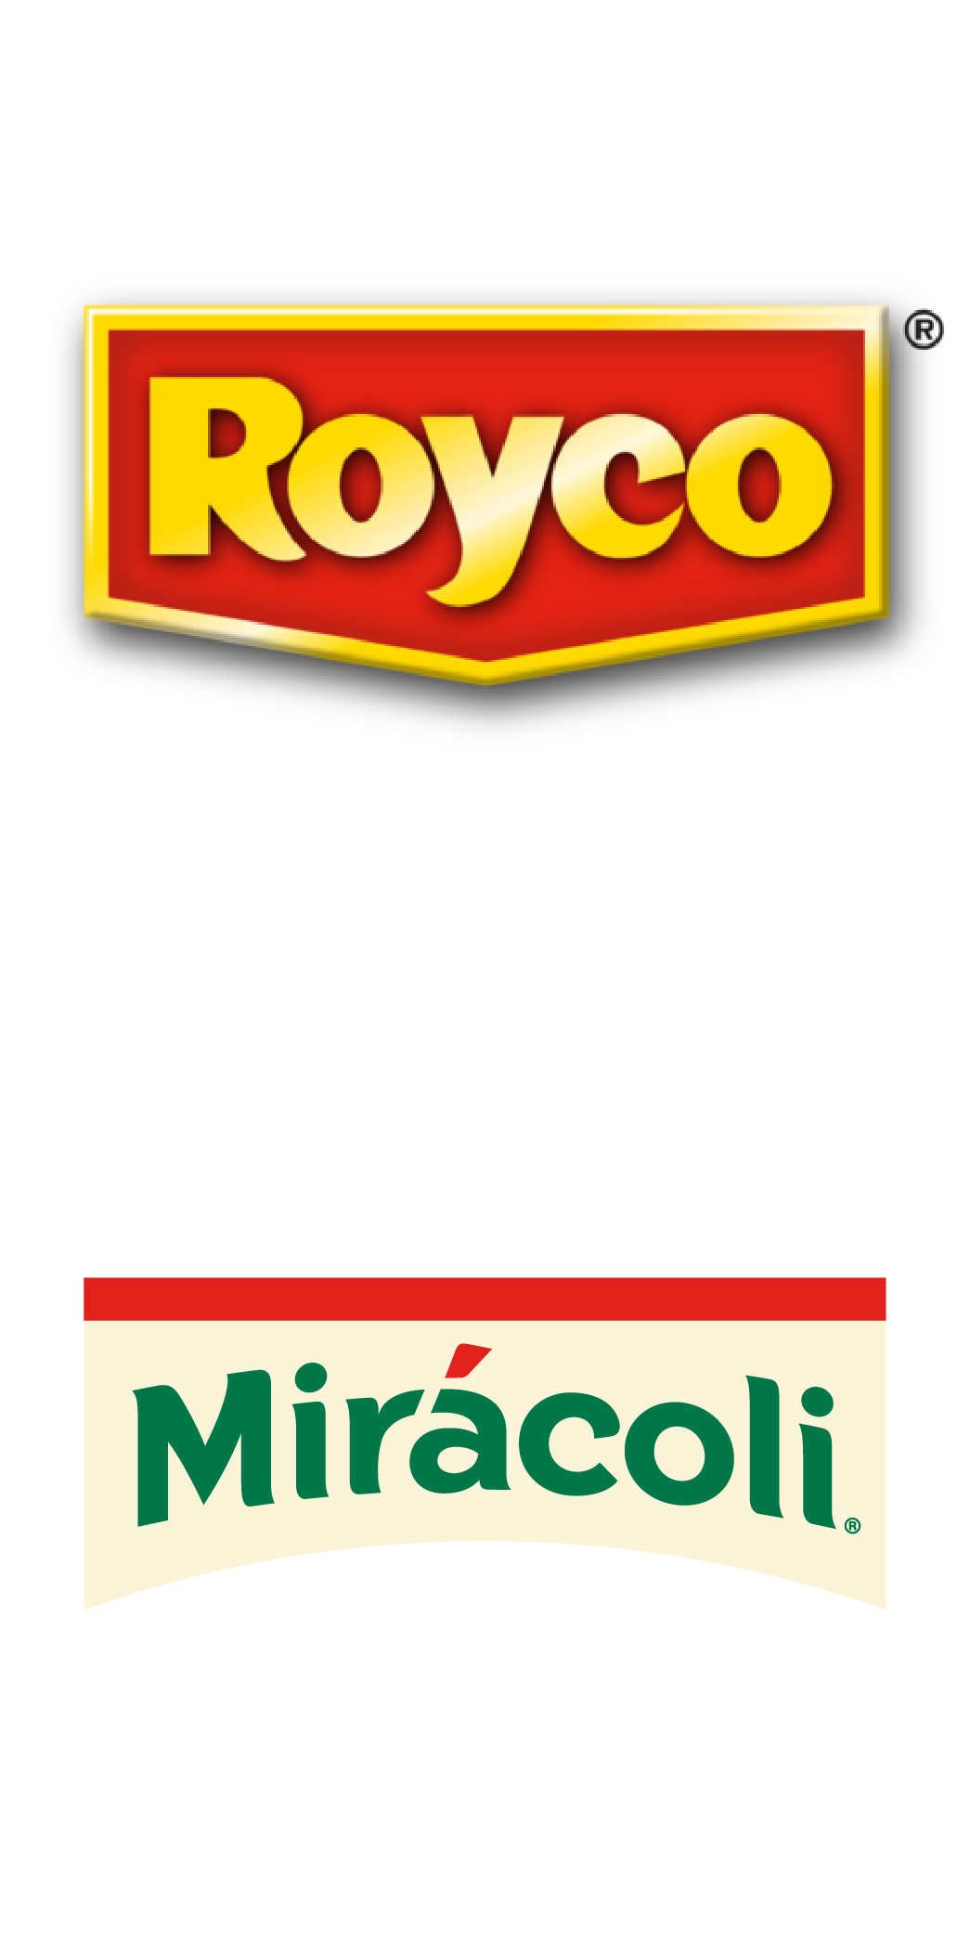
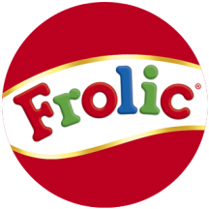
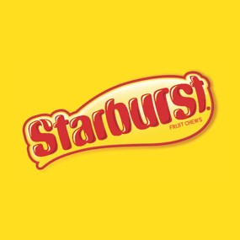

Slide 3
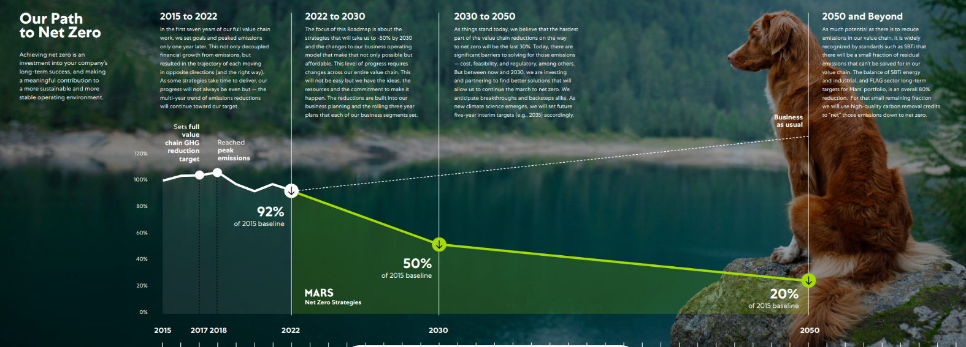
In September, Mars published its Net Zero roadmap to cut emissions 50% by 2030 across full value chain, backed with $1bn three-year spending plan
https://www.mars.com/sustainability-plan/healthy-planet/net-zero-2050

Slide 4
Our brands can have a role to play in engaging consumers : the example of Royal Canin
1. Transitioning to renewable electricity
2. Procuring sustainable ingredients (e.g. ROYAL CANIN®’s sourcing of soy for European factories is already 100% certified by ProTerra)
3. Reducing waste and boosting circularity
4. Climate-smart business transformation (e.g. measuring the carbon footprint of products, enabling climate-smart decision-making regarding formulation, ingredients, raw materials, and logistics)

Slide 5
From farm to bowl: a value chain approach to lower carbon emissions

Slide 6
The EU legislation can support the achievement of net zero for the agri-food sector:
- Favoring a value-chain approach for carbon farming reduction and removals
- Clarifying GhG accounting rules for carbon removals delivered within value chain (aligning with the work of the GhG protocol)
- Setting a framework for environmental claims which is both robust for consumers and workable for companies

